Slide 1
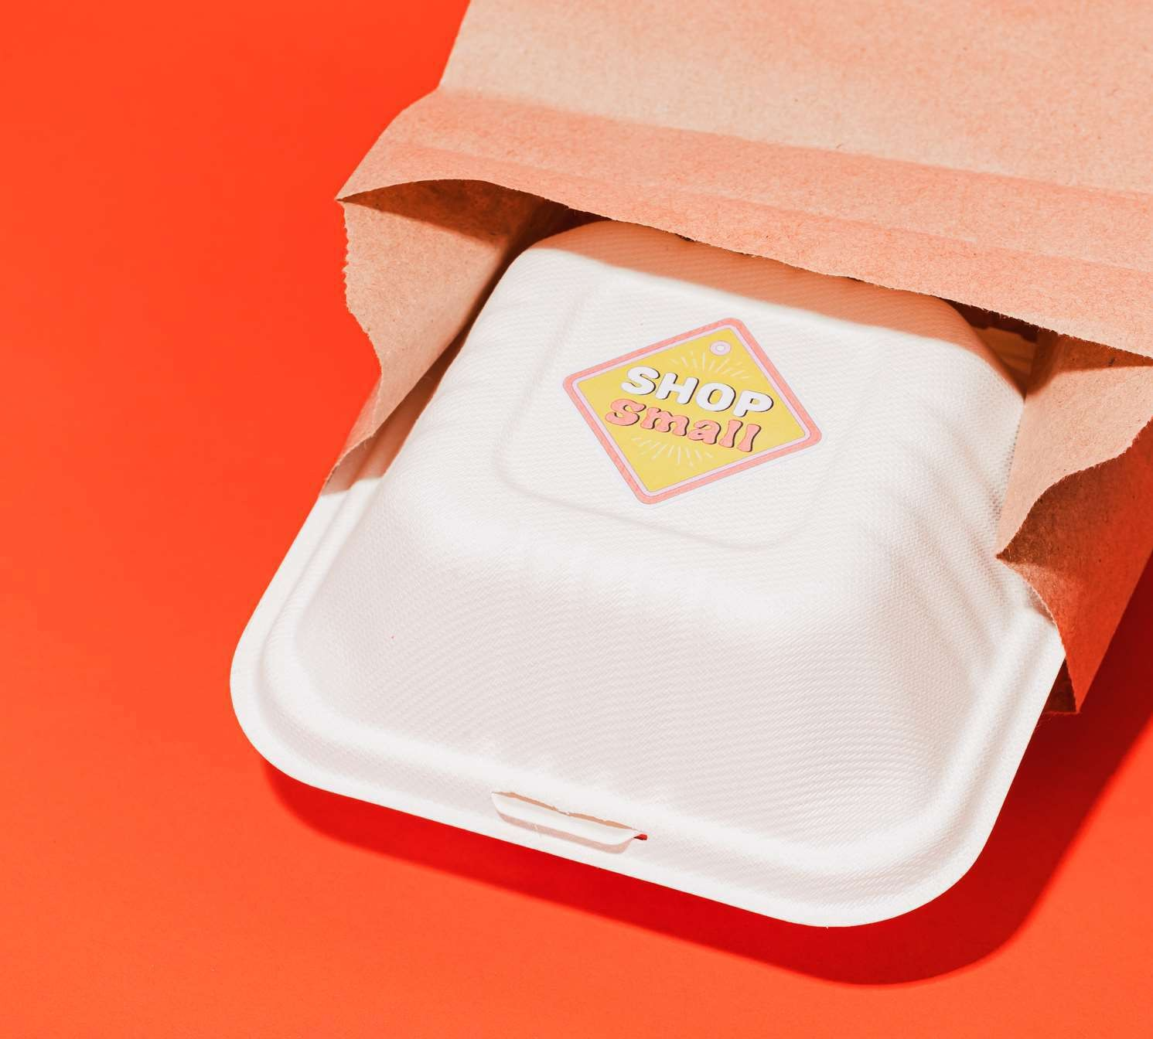
Zomato
Food
2025
Delivery
By: MOhammed
Irshad

Slide 2
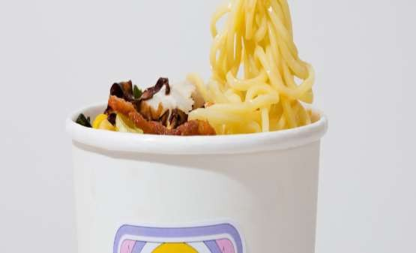
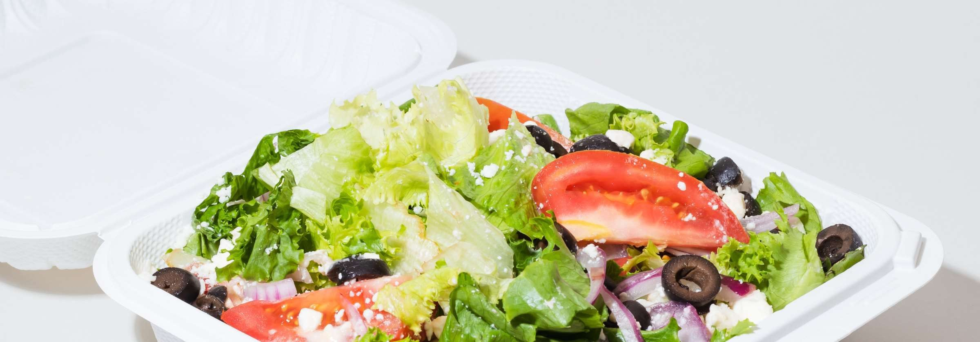
ZOMATO
restaurant
food delivery company. It was founded by Deepinder
Goyal and
Pankaj Chaddah in 2008. Zomato provides information, menus
and user-reviews of restaurants as well as food
delivery options
from partner restaurants in more than 1,000 Indian
cities and
towns. Zomato is an online restaurant discovery guide
providing
information on home delivery, dining-out, caris and nightlife.
Zomato Limited was originally incorporated as a
Private Limited
Company with the name DC Foodie bay Online Services
Private Limited

Slide 3
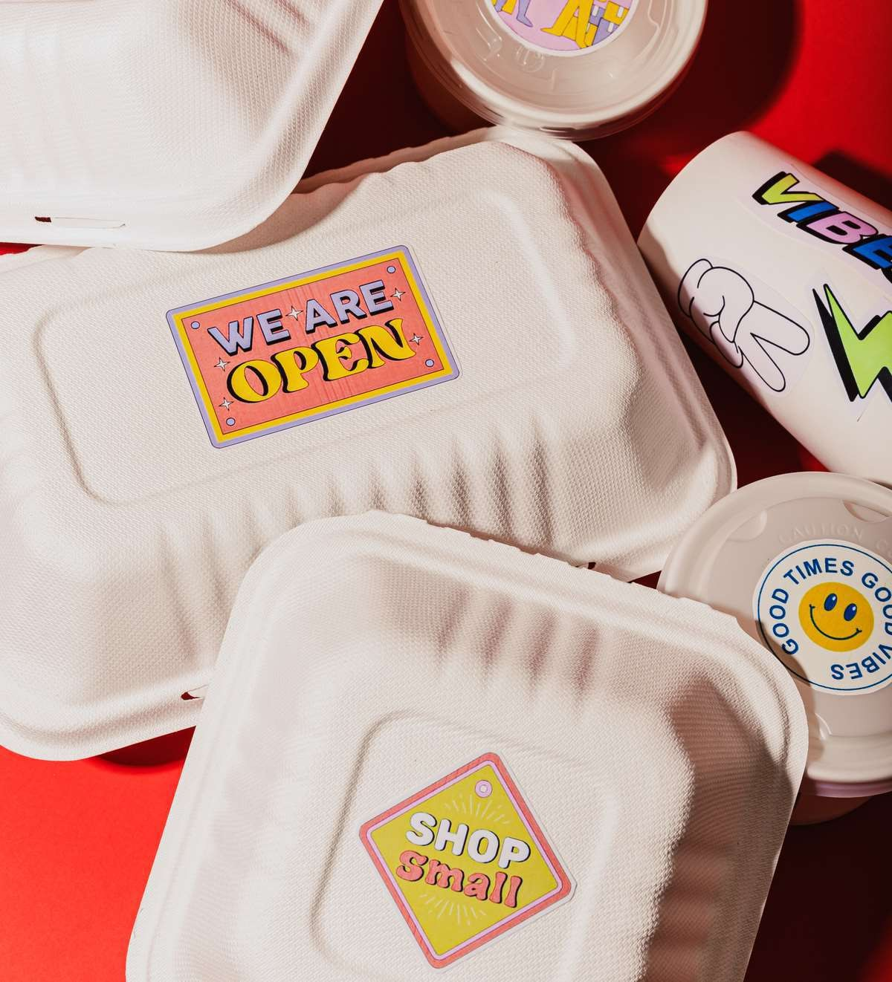

















Launched in 2010, Zomato’s technology platform connects customers, restaurant partners and delivery partners, serving their multiple needs. Customers use the platform to search and discover restaurants, read and write
customer generated reviews and view and upload photos, order food delivery, book a table and make payments while dining-out at restaurants. On the other hand, It provide restaurant partners with industry-specific marketing
tools which enable them to engage and acquire customers
to grow their business while also providing a reliable and efficient last mile delivery service. Zomato also operate
a one-stop procurement solution, Hyper pure, which supplies high quality ingredients and kitchen products to restaurant partners and also provide their delivery partners with transparent and flexible earning opportunities.

Slide 4
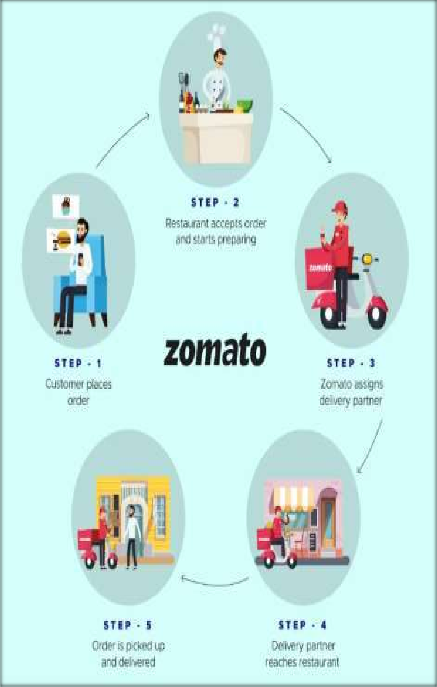
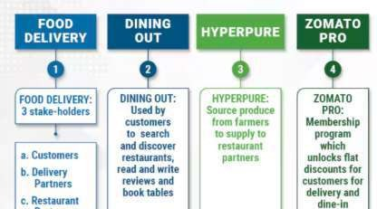
How Zomato Works Zomato is not just a Food delivery app, It works various field in food
industry

Slide 5
Problem Statement
Clearly define the business problem: “Zomato operates in multiple countries, but identifying restaurant trends, customer preferences, and cost structures is challenging. This project analyzes the dataset to extract insights for business decisions.”

Slide 6
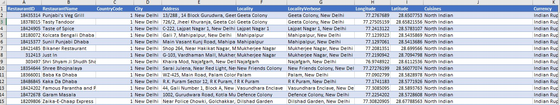
Data overview
There is total of 9551 restaurants present in data.
The restaurants are located in 15 countries and 141 cities.
There are 1824 types of cuisine options including breakfast, lunch, dinner and dessert .
The data contains the date of opening of the restaurant is located in each country.
Information like Rating, Price range, votes, provided with data. The average cost two is also given for reference to pull out insights.
The information like does the restaurant provide online delivery, does it have table booking is
also provided which is beneficial for getting insights.

Slide 7

Data Cleaning
The column like Latitude and Longitude which were having lots of blank values was deleted.
Blank space in cuisine column was filled corresponding to its Country code with most popular cuisines .
Customised column was created for price for two
with its currency symbol.
New column was created to extract country name
using given country code.
Year of opening was separated in separate column.
Price for two was converted in Indian currency and stored in separate column.
The rating was simplified and categorized in 4 parts for further use.

Slide 8
.
Insights from the analyzed project
Country-Level Insights : As India has largest count of restaurants & others Countries like Canada, New Zealand, and Brazil have very few restaurants
Restaurant Growth Trends : You can see there is many changes year by year on the restaurant count
3. Customer Ratings : The average rating is ~3.9, showing moderate satisfaction. Philippines and Brazil have higher average ratings than India, suggesting better customer experiences in smaller markets
4. Top 10 Cuisines : Chinese and Café cuisines dominate globally, with Chinese (354 restaurants) and Café (299) being the most common. Italian (54) and Desserts (53) are less common but still significant.
5. Online Delivery & Table Booking : Online delivery is underutilized – the majority of restaurants do not offer it, despite customer demand.
Table booking is very rare – only a small fraction of restaurants allow advance reservations.
Both are growth opportunities for restaurants and Zomato’s platform.

Slide 9
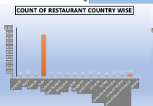
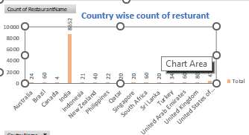



Number of Restaurants in each country
The given chart displays the country wise count of restaurants present in given data. This column chart gives the count of restaurant with comparison other countries
India is the country with highest number of restaurant with 8652
restaurant present in the country
Canada is the country with least number of restaurants with count of 4 restaurants

Slide 10
Insights from the analyzed project
Insight
India dominates the dataset with 8652 restaurants, far surpassing every other country (most others are below 100).
This indicates that either the platform or source has the deepest penetration in India or the data is disproportionately sampled there.
Countries like USA (434) and Brazil (60) are the next highest but still much smaller compared to India.
Recommendations
India-Focused Strategy
Leverage the massive restaurant base to improve services, loyalty programs, and premium offerings.
Explore segmentation by city/tier to refine growth tactics.
Expansion Opportunity
Countries like USA, Brazil, UAE, UK already have some presence; invest in partnerships, localized marketing, and onboarding campaigns to scale faster.
Countries with <50 restaurants represent untapped markets—perform feasibility studies before large investments.
Data Quality & Balance
Check if the skew toward India is due to data collection bias; if so, focus on enriching datasets for other regions.
Competitive Benchmarking
Study competitors’ presence in underrepresented countries to identify quick wins.

Slide 11
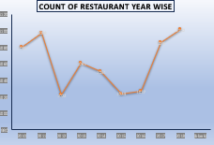
RESTAURENT OPENED IN EACH YEAR
The given chart gives you the year wise count of restaurants opened.
The most number of restaurants were opened in 2018 which
was 1102, followed by year 2011 which was 1098
The least number of restaurants were opened in year 2012
which was 1022
Insight:
The count starts relatively high in 2011–2012, dips sharply around 2013 & 2016, and rebounds again in 2017–2019.
The lowest point seems to be 2016, after which there’s a clear upward trend, peaking by 2019.
The fluctuations may indicate periodic onboarding drives, market dynamics, or changes in data availability.
Recommendations
Investigate Dips (2013, 2016)
Understand operational, economic, or policy reasons for lower counts—e.g., licensing delays, reduced onboarding efforts, or data capture gaps.
Fix underlying issues to prevent repeat slowdowns.
Leverage Growth Years (2017–2019)
Study what strategies worked (marketing, partnerships, technology rollouts) and replicate or enhance them.
Predictive Planning
Use the upward trend post-2016 to forecast demand, staffing, and infrastructure needs.
Develop KPIs around restaurant acquisition targets to maintain growth momentum.

Slide 12
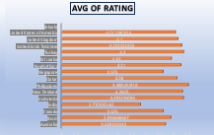
AVERAGE OF RATING.
The average rating of a restaurant is typically calculated by taking the total of all individual ratings given by customers and dividing it by the number of ratings received.
This average helps consumers gauge the overall quality and customer satisfaction of the restaurant compared to others. Different countries and cultures may have variations in how these ratings are interpreted and valued.

Slide 13
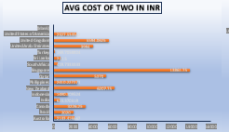
Average cost of Two in INR
The chart shows the Average cost of two person in Indian Rupees for
all countries present in the data
The data contains the price for two persons in the currency with respect
to that specific country. For easy understanding
and evaluation, the
currency was converted in Indian rupees by taking the conversion price
of each respective country.
Singapore is the country having highest cost for
two in Indian currency i.e., 13076.77
Turkey is having lowest cost for two with just 212.98
rs.

Slide 14
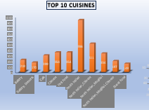
Insight
North Indian Cuisine dominates by a large margin (6186 restaurants), showing massive customer demand and strong supply.
Fast Food (2164) and Chinese (1599) are also very popular, suggesting widespread appeal of quick-service and Asian flavors.
Bakery (1115), Cafe (1396), and Desserts (910) also feature strongly—indicating growing café culture and snacking trends.
Italian (835) and Beverages (901) are mid-tier but still represent solid niche opportunities.
Other cuisines have much smaller footprints, hinting at either limited availability or niche customer bases.
Recommendations
Strengthen Leaders
Keep North Indian, Fast Food, and Chinese menus competitive through menu innovation, value combos, and seasonal specials.
Upsell & Diversify
Cross-promote Bakery, Desserts, and Beverages with meal combos or loyalty points to boost average order value.
Test Premium Niches
Pilot Italian and Café formats in high footfall areas or metro cities—leverage the growing casual dining & coffee culture.
Geo-Targeted Rollouts
Match cuisines with regional taste profiles (e.g., Bakery & Café in urban areas, Fast Food near campuses/offices).
Leverage Marketing
Showcase authenticity & quality for trending cuisines, highlight chef specials, and encourage user-generated content.

Slide 15
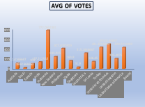
Insights – Average of Votes
India records the highest average votes among all countries. → Indicates a stronger user engagement and feedback culture. → Zomato users in India are more active in rating and reviewing restaurants.
Other countries show significantly lower average votes. → Suggests either fewer Zomato users or less willingness to provide reviews.
Wide variation across countries. → Some countries have almost negligible votes, reflecting low adoption of the voting/review feature.
Recommendations
1. Leverage High Engagement in India
Encourage restaurants to use customer feedback as a competitive advantage.
Highlight top-voted restaurants in campaigns and promotions.
2. Boost Engagement in Low-Vote Countries
Run campaigns to incentivize reviews (e.g., discounts, loyalty points).
Educate users on how their votes improve recommendations.
3. Strengthen Restaurant Onboarding
Train restaurants in low-engagement markets to ask customers for ratings.
Offer small perks (like coupons) for verified reviews.
4. Enhance Platform Features
Simplify the rating process with a one-tap star rating.
Send timely nudges: “How was your meal at X? Rate now in 2 seconds.”
5. Data-driven Strategy
Use India as a benchmark market for best practices.
Replicate successful engagement models in countries with lower review activity.

Slide 16
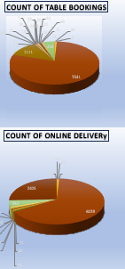
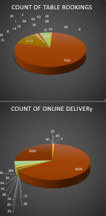
Insights
Customer Behavior
Online Delivery: Higher order frequency during evenings and weekends; driven by convenience and promotions. Repeat orders are common from loyal customers who value speed and reliability.
Offline/Table Booking: Peaks on weekends and special occasions. Many customers prioritize ambiance, personalized service, and dining experience rather than just food.
Revenue Trends
Online orders contribute steady, recurring revenue with lower average ticket size but higher overall volume.
Table bookings deliver higher per-customer spend due to upselling of drinks, desserts, and specials.
Operational Considerations
Delivery relies heavily on quick kitchen turnaround and last-mile logistics.
Offline dining success depends on seating capacity, reservation management, and customer experience.
Recommendations
For Online Delivery
Strengthen partnerships with delivery platforms or build a user-friendly ordering app.
Offer loyalty rewards (free delivery, discounts after X orders) to increase repeat purchase.
Optimize packaging for freshness and branding.
Leverage data (peak hours, top dishes) to run targeted offers.
For Offline Table Booking
Implement an easy reservation system (website, app, or integration with OpenTable/Zomato).
Create experiential dining options (chef’s specials, themed nights, live music) to boost footfall.
Train staff on personalized service and upselling.
Gather post-visit feedback to improve repeat business.

Slide 17
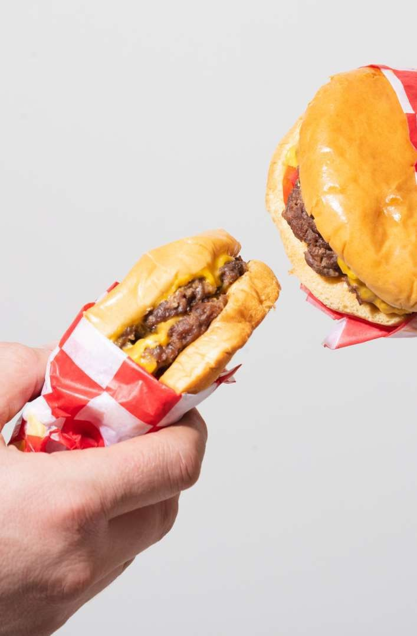
Analytical approach to open new restaurants in selected country
My general approach for opening new restaurant will focus on 4 things
Cuisine – The cuisine which I will select will be Familiar and Favorable to
the Locality where I am planning to open the restaurant.
Price range – I will always go with medium and higher
price like upper
bracket of price range. I will consider the lower price if and only if it has
high demand.
Competition & High Demand - I will generally prefer the area with low
competition and higher demand. Places like Hospitals, School
& Colleges
and working areas.
Service – I will ensure that we provide the best service in that area
where we are working

Slide 18
Overall Recommendations & Conclusion
Strengthen Online Delivery Services
A majority of restaurants do not provide online delivery → onboard more partners to meet the rising demand for convenience.
Expand Table Booking Options
Very few restaurants support table reservations → promote adoption to improve customer experience and loyalty.
Leverage High-Engagement Markets
India shows the strongest user engagement (votes, reviews). Use this as a benchmark market to develop engagement strategies for other regions.
Improve Customer Experience & Ratings
With an average rating of just 2.9, focus on improving food quality, service, and delivery reliability.
Introduce training for restaurants and incentivize better service standards.
Optimize Price Strategy
Average cost for two varies widely across countries. Balance affordability in price-sensitive markets while maximizing margins in premium regions like UAE.
Cuisine Strategy
North Indian and Chinese cuisines dominate demand.
Expand offerings of these cuisines while promoting diversity through new/experimental cuisines to capture broader audiences.
Boost Customer Feedback & Reviews
Encourage users to leave votes and reviews through gamification, rewards, and simplified rating processes.

Slide 19
Conclusion
The study highlights that India is Zomato’s strongest and most engaged market, with the highest restaurant presence and customer interaction. However, other countries lag significantly in engagement, delivery adoption, and reviews, presenting untapped growth opportunities.
To strengthen its global presence, Zomato should:
Expand delivery and booking services,
Enhance customer experience to improve ratings,
Capitalize on high-demand cuisines, and
Replicate India’s engagement strategies internationally.
By aligning restaurant onboarding, customer incentives, and platform improvements, Zomato can drive higher engagement, stronger brand loyalty, and sustainable revenue growth across all markets.

Slide 20
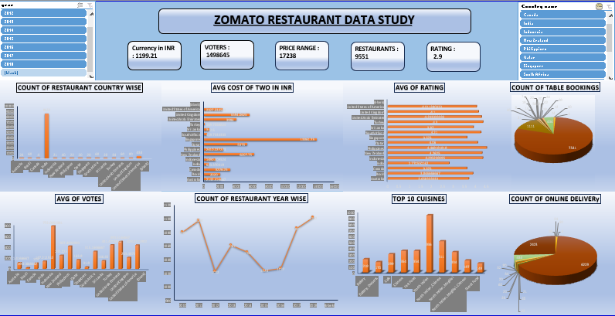
DASHBOARD

Slide 21

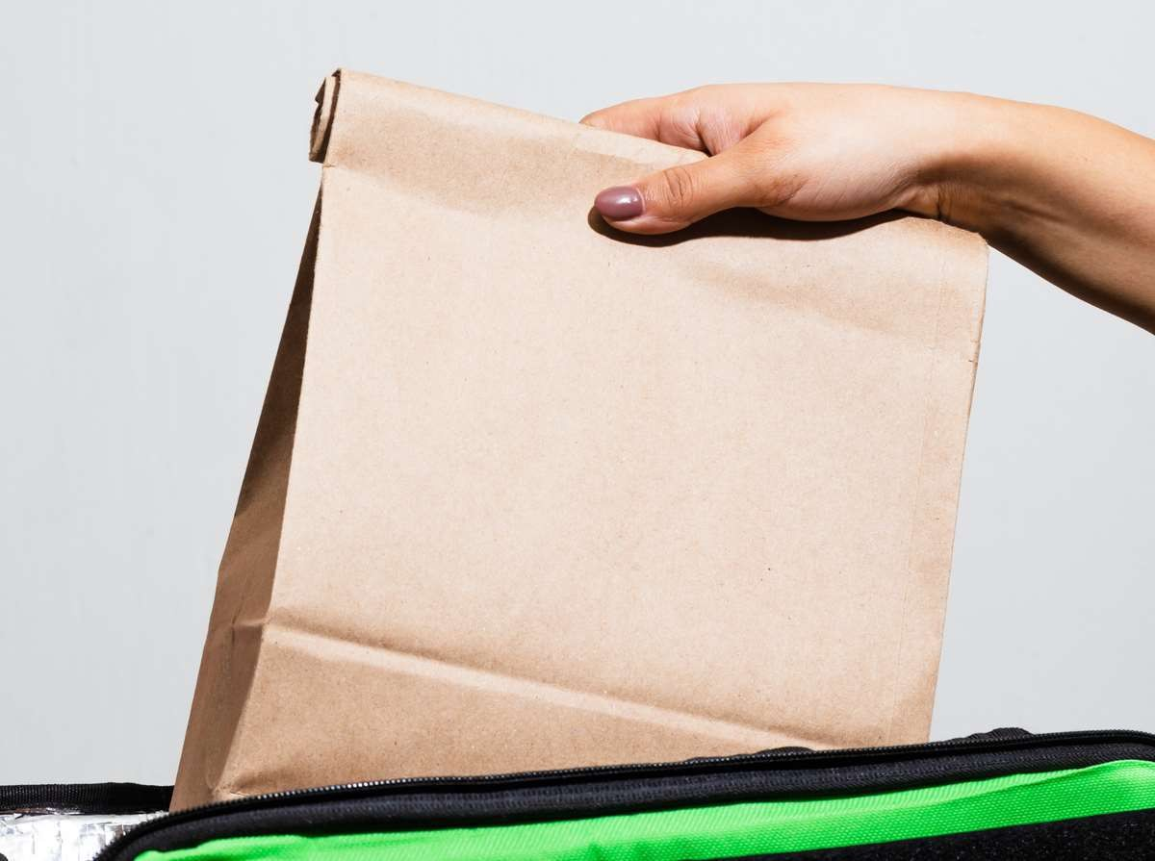
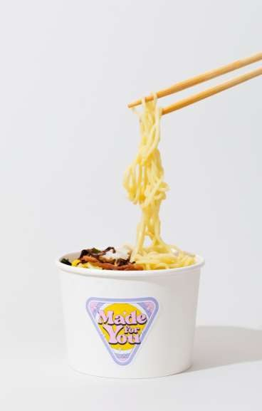

Zomato
Thankyou
Mohammed irshad.

